Slide 1
About the Presentations
The presentations cover the objectives found in the opening of each chapter.
All chapter objectives are listed in the beginning of each presentation.
You may customize the presentations to fit your class needs.
Some figures from the chapters are included. A complete set of images from the book can be found on the Instructor Resources disc.

Slide 2
Ethics in Information Technology, Fourth Edition
Chapter 1
An Overview of Ethics

Slide 3
Objectives
As you read this chapter, consider the following questions:
  What is ethics, and why is it important to act according to a code of ethics?
  Why is business ethics becoming increasingly important?
  What are organizations doing to improve their business ethics?
Ethics in Information Technology, Fourth Edition

Slide 4
Objectives (cont’d.)
  Why are organizations interested in fostering good business ethics?
  What approach can you take to ensure ethical decision making?
  What trends have increased the risk of using information technology in an unethical manner?
Ethics in Information Technology, Fourth Edition

Slide 5
What is Ethics?
Moral code
  Set of rules
  Establishes boundaries of generally accepted behaviour
  Different rules often have contradictions
  Example, if you witness a friend copy someone's else answer while taking exam, you might be caught in a conflict between loyalty to your friend and value of telling the truth.
Ethics in Information Technology, Fourth Edition

Slide 6
Morality
Means(principles concerning the distinction between right and wrong or good and bad behaviour.)
However individual views vary i.e other behavior that are accepted in one culture might be unacceptable in other.
Ethics in Information Technology, Fourth Edition

Slide 7
What is Ethics? (cont’d.)
Morality may vary by:
  Age
  Cultural group
  Ethnic background
  Religion
  Life experiences
  Education
  Gender
  Example :- People debates on issues like Abortion/death penalty are continuously debated. People on both the sides have their own solid moral grounds.
Ethics in Information Technology, Fourth Edition

Slide 8
Definition of Ethics
Ethics
  Set of beliefs about right and wrong behavior
Virtues
  Habits that incline people to do what is acceptable
  Example:- fairness,generosity and loyality
Vices
  Habits of unacceptable behavior
  Example:- greed,anger,envy(desire to have a quality, possession, or other desirable thing belonging to (someone else)
Virtues and vices define a personal value system
  Scheme of moral values
Ethics in Information Technology, Fourth Edition

Slide 9
The Importance of Integrity
(meaning)the quality of being honest and having strong moral principles.
Integrity is a important feature of ethical behaviour.
Example:
In childhood we have been taught not to lie,cheat or steel,
As an adult facing complex decisions,you often reflect on your principles,when you consider what to do in different situation.
Ethics in Information Technology, Fourth Edition

Slide 10
People with integrity:
  Act in accordance with a personal code of principles
  Extend to all the same respect and consideration
  Apply the same moral standards in all situations
Lack of integrity emerges if you apply moral standards differently according to situation or people involve. Example if you have worked overtime and that should not be included in report due to budget constraints(moral conflict arises).
Ethics in Information Technology, Fourth Edition

Slide 11
The Difference Between Morals,
Ethics, and Laws
Morals: one’s personal beliefs about right and wrong
Ethics: standards or codes of behavior expected of an individual by a group(eg. To defend an accused client in court)
Law: system of rules that tells us what we can and cannot do
  Laws are enforced by a set of institutions
  Legal acts conform to the law
  Moral acts conform to what an individual believes is the right belief of right and wrong.
  Law can proclaim an act as legal,while other may consider it as the act of immoral- for example absortion.
Ethics in Information Technology, Fourth Edition

Slide 12
Ethics in the Business World
Both the likelihood and the negative impact of inappropriate behavior have increased
Several trends have increased the likelihood of unethical behavior:
  Globalization creating complex work environments
  Organizations challenged to maintain profits / revenue
  Heightened vigilance(watchfulness) by:
    Employees
    Shareholders
    Regulatory agencies
Ethics in Information Technology, Fourth Edition

Slide 13
Ethics in the Business World (cont’d.)
Recent scandals in IT companies
  Satyam Computer Services (India)
  Hewlett Packard
  Computer Associates International
  IBM
  https://www.businessinsider.in/The-17-biggest-tech-scandals-of-2017/February-Self-driving-car-company-Waymo-sues-Uber-accusing-it-of-stealing-its-technology-/slideshow/62309185.cms
Not just executives, but even lower-level employees, can find themselves in the middle of an ethical dilemma:- example :- information leaked of 30 lawmakers by a staff member
Ethics in Information Technology, Fourth Edition

Slide 14
Unethical examples in real world
Exploiting Workers
Tax loopholes:-Some businesses exploit tax loopholes to avoid paying taxes in the United States, while raking in billions in profits.
Dumping Toxins
Unnecessary Medical Procedures
Ethics in Information Technology, Fourth Edition

Slide 15
Why Fostering Good Business Ethics
Is Important
Fostering:-encourage the development of (something, especially something desirable).
To gain the good will of the community
To create an organization that operates consistently
To foster good business practices
To protect organization/employees from legal action
To avoid unfavorable publicity
Ethics in Information Technology, Fourth Edition

Slide 16
Gaining the Good Will of the Community
Organizations have fundamental responsibilities to society
  Declared in formal statement of company’s principles or beliefs
  Include:
    Making contributions to charitable organizations and nonprofit institutions
    Providing benefits for employees in excess of legal requirements
Ethics in Information Technology, Fourth Edition

Slide 17
Gaining the Good Will of the Community (cont’d.)
Socially responsible activities create good will
Good will makes it easier for corporations to conduct business
Example:-
Comacast corporation:- made chahritable contributions of more than $406 million in 2009.
Ethics in Information Technology, Fourth Edition

Slide 18
Creating an Organization That Operates Consistently
Consistency ensures that employees:
  Know what is expected of them
  Can employ the organization’s values to help them in decision making
Consistency also means that shareholders, customers, suppliers, and community know what they can expect of the organization
Ethics in Information Technology, Fourth Edition

Slide 19
Creating an Organization That Operates Consistently (cont’d.)
Many companies share the following values:
  Operate with honesty and integrity, staying true to organizational principles
  Operate according to standards of ethical conduct, in words and action
  Treat colleagues, customers, and consumers with respect
  Strive to be the best at what matters to the company
  Value diversity
  Make decisions based on facts and principles
Ethics in Information Technology, Fourth Edition

Slide 20
Fostering Good Business Practices
Good ethics means good business/improved profits
Companies that:
  Produce safe and effective products
    Avoid costly recalls and lawsuits
  Provide excellent service that retains customers
  Develop and maintain strong employee relations
    Enjoy better employee morale
Ethics in Information Technology, Fourth Edition

Slide 21
Fostering Good Business Practices (cont’d.)
Suppliers/business partners place priority on working with companies that operate in a fair and ethical manner
Bad ethics means bad business/waning profits
  Bad ethics can lead to bad business results
  Bad ethics can have a negative impact on employees
Ethics in Information Technology, Fourth Edition

Slide 22
Avoiding Unfavorable Publicity
Public reputation of company strongly influences:
  Value of its stock
  How consumers regard products and services
  Degree of oversight received from government
  Amount of support and cooperation received
Organizations are motivated to build strong ethics programs to avoid negative publicity
Ethics in Information Technology, Fourth Edition

Slide 23
Improving Corporate Ethics
Characteristics of a successful ethics program
  Employees willing to seek advice about ethical issues
  Employees feel prepared to handle situations that could lead to misconduct
  Employees are rewarded for ethical behavior
  Employees are not rewarded for success obtained through questionable means
  Employees feel positive about their company
Ethics in Information Technology, Fourth Edition

Slide 24
Appointing a Corporate Ethics Officer
Corporate ethics officer
  Provides vision and leadership in business conduct
  Should be well-respected, senior-level manager who reports directly to the CEO
  Ensures ethical procedures are put in place
  Creates and maintains ethics culture
  Is responsible for key knowledge/contact person for ethical issues
Ethics in Information Technology, Fourth Edition

Slide 25
Ethical Standards Set by Board of Directors
Board oversees the organization’s business activities and management
Board members of company are expected to:
  Conduct themselves according to the highest standards of personal and professional integrity
  Set standard for company-wide ethical conduct
  Ensure compliance with laws and regulations
  Create environment in which employees can seek advice about business conduct, raise issues, and report misconduct
Ethics in Information Technology, Fourth Edition

Slide 26
Establishing a Corporate Code of Ethics
Code of ethics
  Highlights an organization’s key ethical issues
  Identifies important principles
  Focuses employees on areas of ethical risk
  Offers guidance for employees to recognize and deal with ethical issues
  Provides mechanisms to report unethical conduct
  Help employees abide by the law, follow necessary regulations, and behave in an ethical manner
Ethics in Information Technology, Fourth Edition

Slide 27
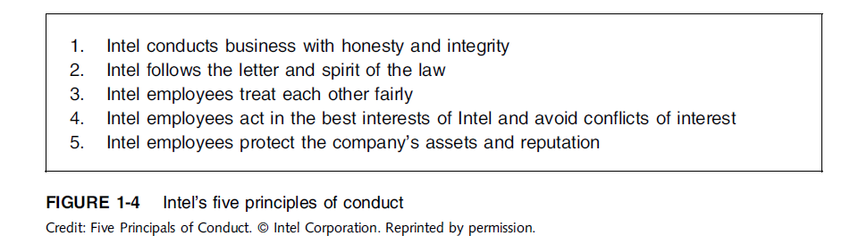
Establishing a Corporate
Code of Ethics (cont’d.)
Ethics in Information Technology, Fourth Edition

Slide 28
Conducting Social Audits
Social audit
Meaning(A social audit is a way of measuring, understanding, reporting and ultimately improving an organization's social and ethical performance. A social audit helps to narrow gaps between vision/goal and reality, between efficiency and effectiveness.)
  Reviews how well organization is meeting ethical and social responsibility goals
  Communicates new goals for upcoming year
  Shared broadly with employees, shareholders, investors, market analysts, customers, suppliers, government agencies, and local communities
Ethics in Information Technology, Fourth Edition

Slide 29
Requiring Employees to
Take Ethics Training
Personal convictions improved through education
Comprehensive ethics education program encourages employees to act responsibly and ethically
  Often presented in small workshop formats
  Employees apply code of ethics to hypothetical but realistic case studies
  Demonstration of recent company decisions based on principles from the code of ethics
Ethics in Information Technology, Fourth Edition

Slide 30
Requiring Employees to
Take Ethics Training (cont’d.)
Employees must:
  Learn effective ways of reporting incidents
  Be reassured their feedback will be acted on without retaliation(revenge)
Ethics in Information Technology, Fourth Edition

Slide 31
Including Ethical Criteria in
Employee Appraisals
Only 43% of companies include ethical conduct in employee’s performance appraisal
Ethical criteria include:
  Treating others fairly and with respect
  Operating effectively in a multicultural environment
  Accepting personal accountability
  Continually developing themselves and others
  Operating openly and honestly with all
Ethics in Information Technology, Fourth Edition

Slide 32
Creating an Ethical Work Environment
Good employees may make bad ethical choices
May be encouraged to do “whatever it takes” to get the job done
Employees need a knowledgeable resource to discuss perceived unethical practices
  A manager
  Legal or Internal Audit Department
  Business Unit’s legal counsel
  Anonymously through internal Web site
Ethics in Information Technology, Fourth Edition

Slide 33
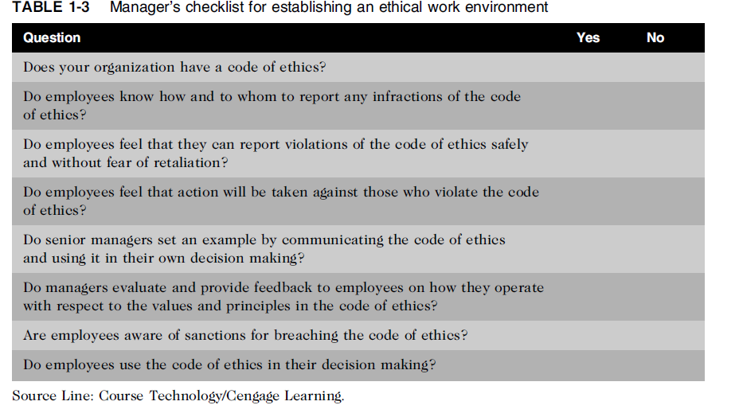
Creating an Ethical Work Environment (cont’d.)
Ethics in Information Technology, Fourth Edition

Slide 34
2nd half
Ethics in Information Technology, Fourth Edition

Slide 35
Including Ethical Considerations in Decision Making
Steps in a decision-making process
  Develop problem statement
  Identify alternatives
  Evaluate and choose alternative
  Implement decision
  Evaluate results
  Success
  Task:- Pantaloons and Lenskart.
Ethics in Information Technology, Fourth Edition

Slide 36
Develop a Problem Statement
Clear, concise description of the issue
Answers these questions:
  What causes people to think there is a problem?
  Who is directly affected by the problem?
  Is there anyone else affected?
  How often does it occur?
  What is the impact of the problem?
  How serious is the problem?
Most critical step in decision-making process
Ethics in Information Technology, Fourth Edition

Slide 37
Develop a Problem Statement (cont’d.)
Example of a good problem statement:
  “Our product supply organization is continually running out of stock of finished products, creating an out-of-stock situation on over 15 percent of our customer orders, resulting in over $300,000 in lost sales per month.”
Examples of poor problem statements:
  “We need to implement a new inventory control system.” (possible solution, not a problem statement)
  “We have a problem with finished product inventory.” (not specific enough)
Ethics in Information Technology, Fourth Edition

Slide 38
Identify, Evaluate, and Choose an Alternative
Enlist help to brainstorm alternative solutions
Evaluate by weighing laws, guidelines, and principles
Consider likely consequences of each alternative
Alternative selected must:
  Be ethically and legally defensible
  Be consistent with policies and code of ethics
  Take into account impact on others
  Provide a good solution to problem
Ethics in Information Technology, Fourth Edition

Slide 39
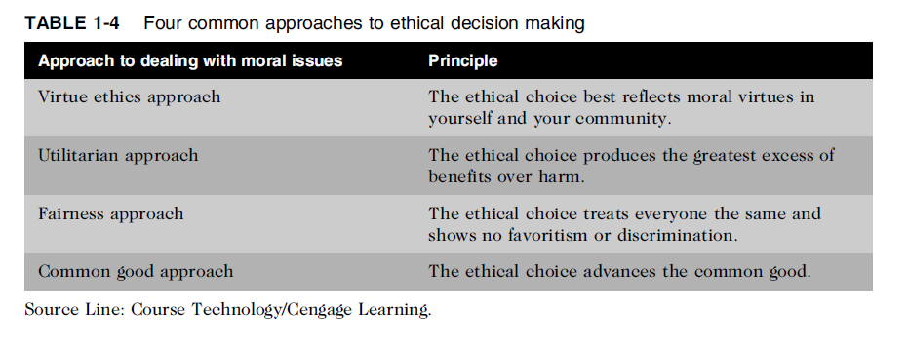
Common Approaches to Ethical Decision Making
Table 1-5 Four common approaches to ethical decision making
Ethics in Information Technology, Fourth Edition

Slide 40
Virtue Ethics Approach
Virtue ethics approach
  Focuses on concern with daily life in a community
  More effective than following set of principles/rules
  Suggests that when faced a situation either people do what they are most comfortable or what they think a person they admire would do.
Problems
  Does not provide guide for action
  Virtue cannot be worked out objectively; depends on circumstances. Example bravery is a great virtue in many situations but in others it may be foolish
Ethics in Information Technology, Fourth Edition

Slide 41
Utilitarian Approach
Utilitarian approach
  Chooses action that has best overall consequences
  Finds the greatest good by balancing all interests
  Fits concept of value in economics and the use of cost-benefit analysis
  Utilitarianism appears to be a simple theory because it consists of only one evaluative principle: Do what produces the best consequences
Problems
  Measuring and comparing values is often difficult
  Predicting resulting benefits and harm is difficult
Ethics in Information Technology, Fourth Edition

Slide 42
Examples of Utilitarian Ethics
One example of utilitarianism in business is the practice of having tiered pricing for a product or service to different types of customers. For example, the airline industry offers first class, business class and economy class seats on many of their airplanes.
Customers who fly in first or business class pay a much higher rate than those in economy seats, but they also get more amenities. However, the higher prices paid for business or first class seats help to ease the airline’s financial burden created by making room for economy class seats. This would be an example of rule utilitarianism.
Ethics in Information Technology, Fourth Edition

Slide 43
An example of act utilitarianism is a pharmaceutical company releasing a drug that has been governmentally approved with known side effects because the drug is able to help more people than are bothered by the minor side effects. Act utilitarianism often shows “the end justifies the means” mentality.
Ethics in Information Technology, Fourth Edition

Slide 44
Fairness Approach
Fairness approach
  Focuses on fair distribution of benefits/burdens
  Guiding principle is to treat all people the same
Problems
  Decisions can be influenced by personal bias
  Others may consider the decision unfair
Ethics in Information Technology, Fourth Edition

Slide 45
Common Good Approach
Common good approach
  Work together for common set of values and goals
  Implement systems that benefit all people
Problems
  Consensus (a general agreement.)is difficult
  Some required to bear greater costs than others
  .
Ethics in Information Technology, Fourth Edition

Slide 46
Implement the Decision and
Evaluate the Results
Implement the decision
  Efficient, effective, timely implementation
  Communication is key for people to accept change
Evaluate the results
  Monitor results for desired effect
  Observe impact on organization and stakeholders
  Return to “Develop problem statement” step if further refinements may be needed
Ethics in Information Technology, Fourth Edition

Slide 47
Ethics in Information Technology
Public concern about the ethical use of information technology includes:
  E-mail and Internet access monitoring
  Downloading in violation of copyright laws
  Unsolicited e-mail (spam)
  Hackers and identify theft
  Students and plagiarism
  Cookies and spyware
Ethics in Information Technology, Fourth Edition

Slide 48
Ethics in Information Technology (cont’d.)
The general public does not understand the critical importance of ethics as applied to IT
Important decisions are often left to technical experts
General business managers must assume greater responsibility for these decisions by:
  Making decisions based on technical savvy, business know-how, and a sense of ethics
  Creating an environment where ethical dilemmas can be discussed openly, objectively, and constructively
Ethics in Information Technology, Fourth Edition

Slide 49
Ethics in Information Technology (cont’d.)
Goals of this text
  To educate people about the tremendous impact of ethical issues in the successful and secure use of information technology
  To motivate people to recognize these issues when making business decisions
  To provide tools, approaches, and useful insights for making ethical decisions
Ethics in Information Technology, Fourth Edition

Slide 50
Summary
Ethics is important because the risks associated with inappropriate behavior have increased
Organizations have at least five good reasons for encouraging employees to act ethically
  To gain the good will of the community
  To create an organization that operates consistently
  To foster good business practices
  To protect the organization and its employees against legal action
  To avoid unfavorable publicity
Ethics in Information Technology, Fourth Edition

Slide 51
Summary (cont’d.)
Organizations require successful ethics programs
The corporate ethics officer ensures that ethical procedures are installed and followed
Managers’ behaviors and expectations can strongly influence employees’ ethical behavior
Most of us have developed a simple decision-making model that includes five steps
Ethical considerations must be incorporated into decision making
Ethics in Information Technology, Fourth Edition

Slide 52
Summary (cont’d.)
Four common approaches to ethical decision making
  Virtue ethics approach
  Utilitarian approach
  Fairness approach
  Common good approach
Ethics in Information Technology, Fourth Edition

